Slide 1
HARMFUL GAS DETECTION SYSTEM
Presented By:
Saurabh Biswas
Swani Chatterjee
Suryashmi Chakraborty
Under the Guidance of Mr. Durjoy Roy.

Slide 2
FLOW OF THE PRESENTATION
Brief Description of the Project
Materials used
Elaboration of Arduino Uno
Elaboration of Sensors used
GSM Module
Power Supply of the circuit
Programming
Output & Results
Conclusion
Future Enhancements
References

Slide 3

OBJECTIVE
The primary objective is to monitor the
concentration levels of harmful gases in
surroundings of the butterflies.
The device detects toxic gases, including
CO, CO₂, SO₂, NO₂, NO, NH₂, O₃, and
H2S.

Slide 4

MATERIALS USED
Arduino UNO
The Sensors used in our project includes: MQ-7 Sensor, MQ-135 Sensor, AGS02MA Sensor (TVOC Sensor), DHT11 sensor.
SIM900A GSM module
Batteries, Wires and Boost Converter for the external voltage supply.

Slide 5
ARDUINO UNO It is based on Atmega328 Microcontroller.
Key Points
It includes a set of digital input/output (I/O) pins and analog input pins.
It supports serial communication through USB, enabling seamless interaction with computers for code upload, data exchange, and debugging.
The board is equipped with UART, I2C, and SPI interfaces.

Slide 6
Microcontroller ATmega328P
The ATmega328P is a 8-bit microcontroller.
ATmega328P uses Reduced Instruction Set Computer (RISC) architecture.
Operates at a clock speed of 16 MHz.
Its has a non-volatile flash memory of 32KB.
It also features 1KB of EEPROM.

Slide 7
Memory unit & I/O Ports
Flash Memory
SRAM
EEPROM
Digital I/O Ports
Analog Input Ports
Power Pins
Special Function Pins

Slide 8
OPERATION
POWERING THE ARDUINO UNO
SKETCH UPLOAD
SETUP FUNCTION
LOOP FUNCTION
DIGITAL AND ANALOG I/O PINS
SERIAL COMMUNICATION
LOOP EXECUTION

Slide 9
SENSORS A sensor is a device or an instrument that detects and measures physical properties or changes in the environment and converts them into electrical signals or other readable formats.
CHARACTERSTICS OF SENSORS TYPES OF SENSORS
Sensitivity Temperature Sensor
Range Gas Sensor
Accuracy Image Sensor
Precision Light Sensor
Resolution Humidity Sensor
SENSORS USED IN THIS DEVICE
Here we are using the Gas sensors. The sensors used for CO detection is MQ-7, for detecting CO₂ is MQ-135 sensor, for detecting SO₂, NO₂, NO, O₃, H₂S (i.e. VOC) is AGSM02A(TVOC Sensor) and DHT11 sensor for Temperature and Humidity detection.

Slide 10
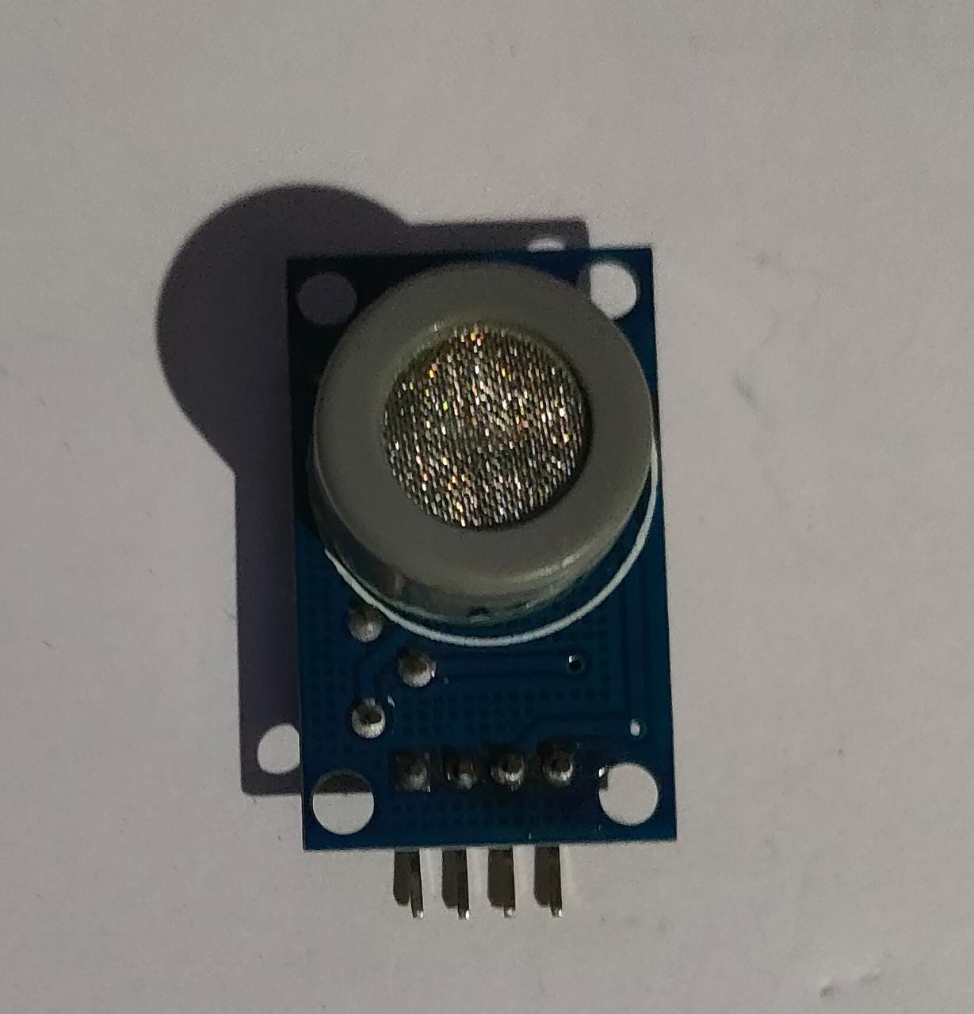
MQ-7 Sensor The MQ-7 sensor is a type of gas sensor widely used to detect carbon monoxide (CO) gas. The MQ-7 sensor is available in a compact and portable module.
SPECIFICATIONS
Gas Detected: Carbon Monoxide (CO)
Sensing Material: Tin Dioxide (SnO₂)
Heater Voltage: operates at 5V DC
Target Gas Concentration Range: Usually 10 to 500 ppm
Output Signal: Analog voltage output (varies with CO concentration)

Slide 11
WORKING PRINCIPLES
Oxidation of Tin Dioxide (SnO2): SnO₂ (sensing element) + O₂ (air) ⟶ SnO₂ (unchanged)
Adsorption of Carbon Monoxide (CO):
SnO₂ (sensing element) + CO (atmosphere) ⟶ SnO₂-CO complex
Change in Conductivity: change in conductivity is the key factor that allows the MQ-7 sensor to detect the presence of CO gas.
Output Voltage Variation: By measuring and interpreting the output voltage, the sensor can provide an estimate of the CO gas concentration in parts per million (ppm).
SIGNIFICANCE
Research and Experimentation
Internet of Things (IoT) Devices

Slide 12
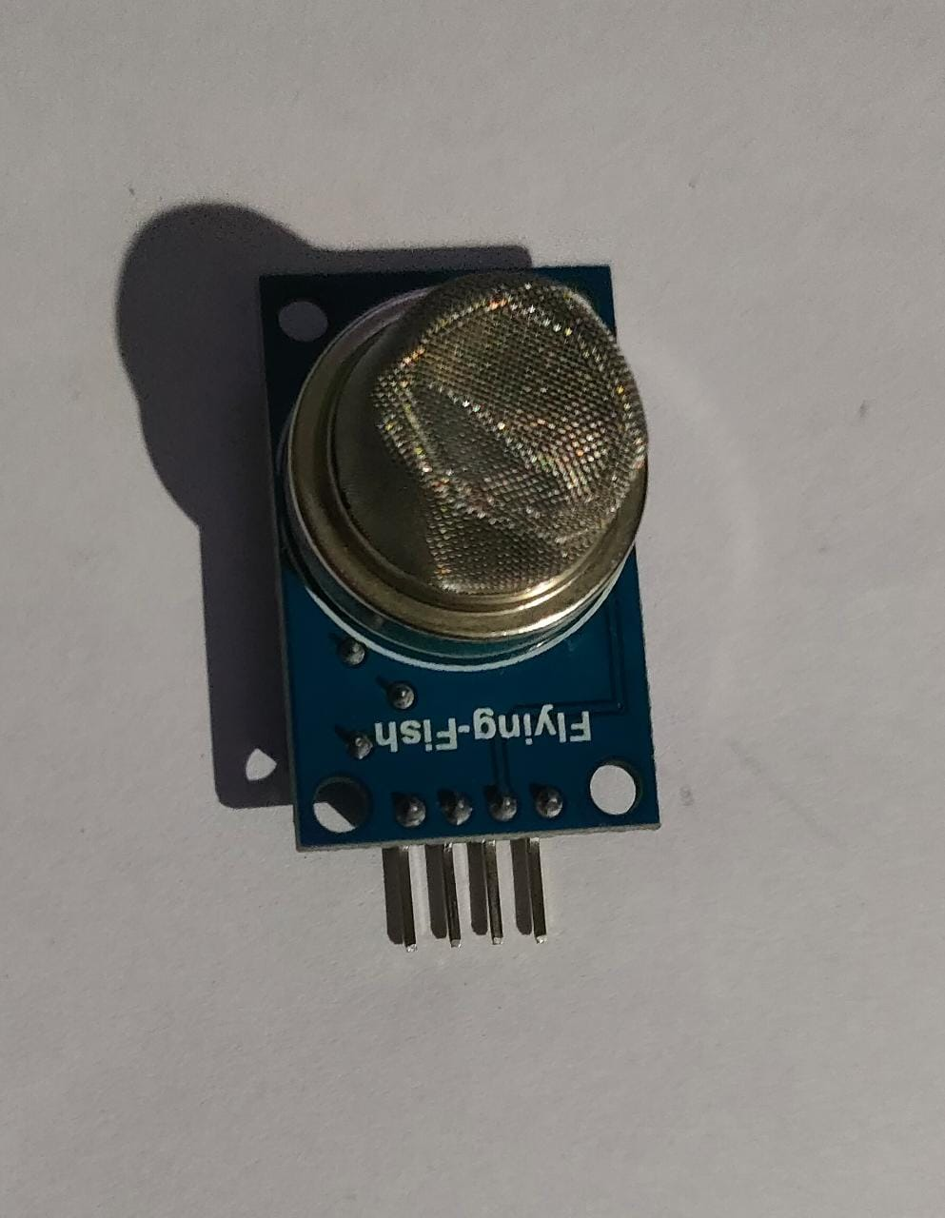
MQ-135 Sensor The MQ-135 sensor is a gas sensor commonly used to detect and measure air quality, it is also used for CO₂ detection.
SPECIFICATIONS
Gas Detected: Carbon-di-oxide(CO₂)
Sensing Material: SnO₂ (tin dioxide)
Heater Voltage: operates at 5V DC
Target Gas Concentration Range: detects 10s to 100s of PPM.
Output Signal: Analog voltage output (varies with gas concentration).

Slide 13
WORKING PRINCIPLE
Steps involved in the working of MQ-135 Sensor
Infrared Light Source
Gas Sample Chamber
Absorption of Infrared Radiation
Detector
Signal Processing
Output
SIGNIFICANCE
Research and Experimentation
Internet of Things (IoT) Devices
Portable Gas Detectors

Slide 14
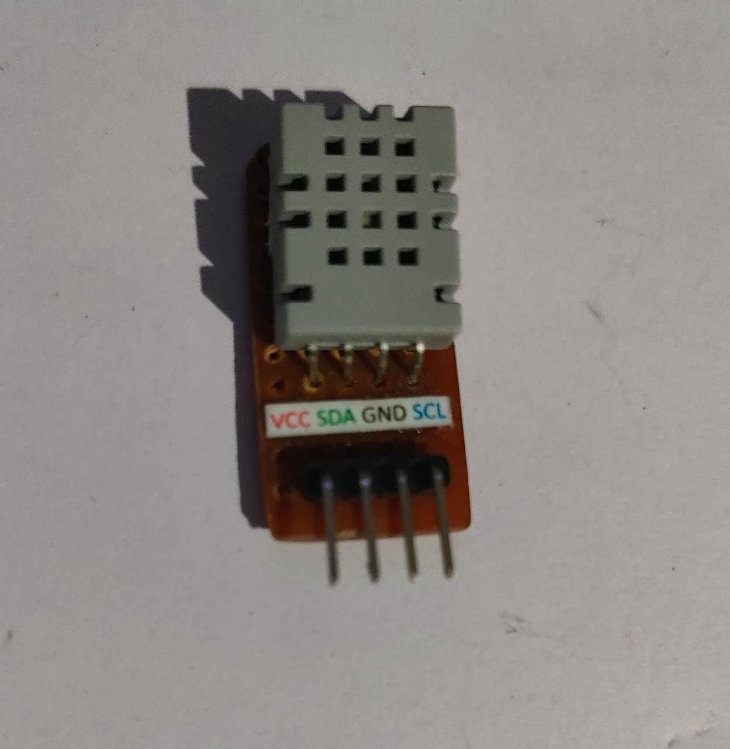
AGS02MA Sensor The AGS02MA also know as TVOC sensor is used to detect Volatile Organic Compounds (VOCs).
SPECIFICATIONS
Gas Detected: NH₃, NO, NO₂, O₃, SO₂
Sensing Principle: Catalytic sensor
Heater Voltage: operates at 5V DC
Target Gas Concentration Range: measures in ppb
Output Signal: Analog voltage output

Slide 15
Materials Used in AGS02MA Sensor The AGS02MA sensor utilizes a catalytic element made of platinum or other noble metals.
WORKING PRINCIPLE
Resistance Change
Signal Processing
Output Signal
SIGNIFICANCE
Gas Leak Detection
Research and Experimentation
Internet of Things (IoT) Devices

Slide 16
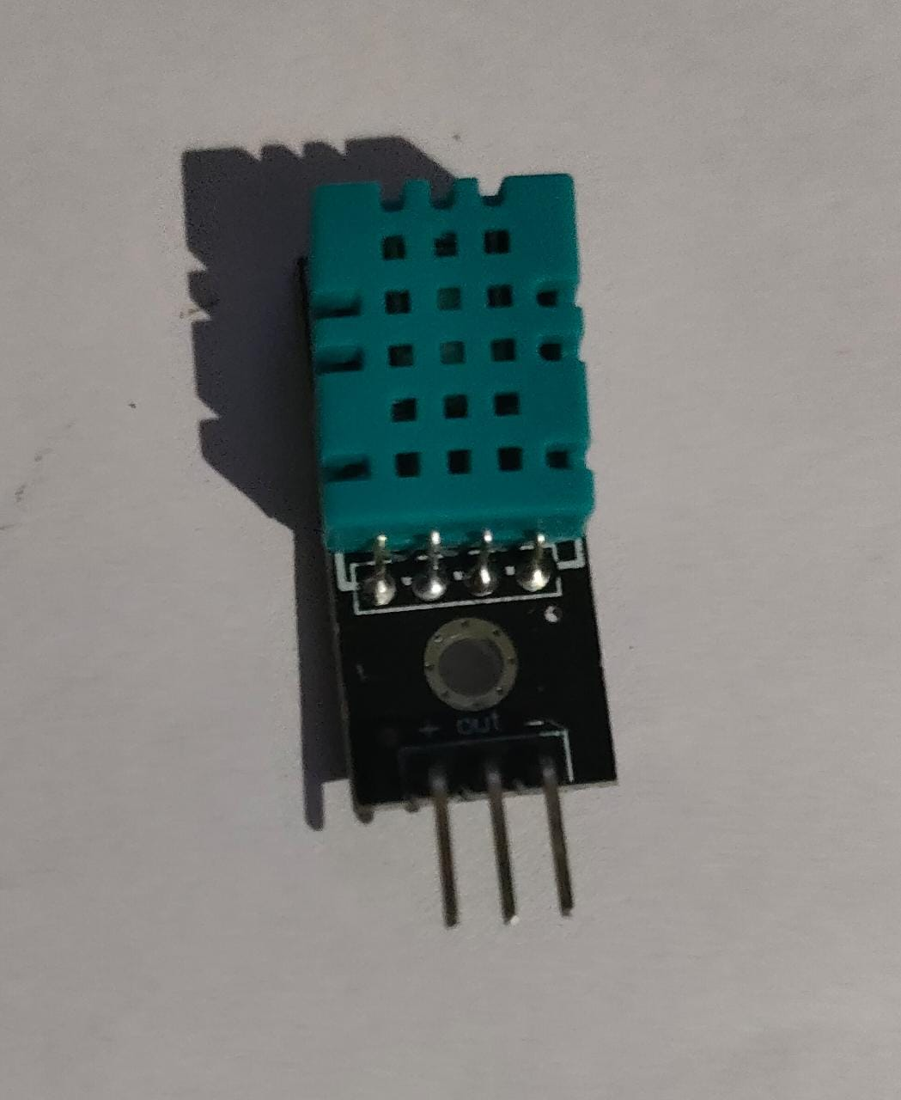
DHT11 sensor The DHT11 sensor operates at a low voltage i.e. 3.3V to 5V DC. It provides relatively basic accuracy for temperature and humidity measurements.
SPECIFICATIONS
Sensor Type: Digital Temperature and Humidity Sensor
Sensing Parameters: Temperature and relative humidity
Temperature Measurement Range: 0°C to 50°C
Humidity Measurement Range: 20% RH to 90% RH
Operating Voltage: 3.3V to 5V DC

Slide 17
WORKING PRINCIPLE
Sensing Element
Temperature Sensor
Signal Processing
Timing and Communication
SIGNIFICANCE
Cost-Effectiveness
Environmental Monitoring
Internet of Things (IoT) Devices

Slide 18
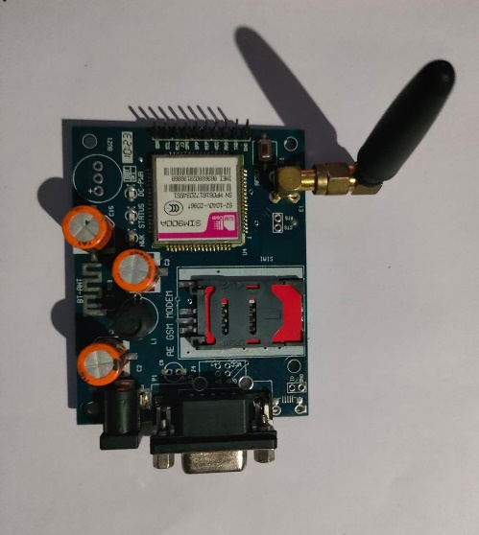
GSM MODULE A GSM module is a hardware device used to enable communication over the Global System for Mobile Communications (GSM) network. The GSM module consists of a GSM modem, a SIM card holder, antenna connector, and serial communication interface.
KEY FEATURE OF GSM MODULE
REMOTE SENSING
Since this device focuses on tracking the surroundings of Butterflies as they are the main pollinator for the environment so, by remote sensing we are able to get the data without disturbing their natural Habitat.

Slide 19
SIM900A GSM MODULE Manufacturer - SIMCom. An improved version of the SIM900 module and is widely used in various applications that require GSM communication capabilities. The SIM900A module offers features like SMS messaging, voice calling, and GPRS data transmission.
KEY FEATURES APPLICATIONS
Communication interfaces Remote Monitoring and Control
SIM Card Holder IoT Devices
SMS Messaging Weather Stations
GPRS Data Transmission Alarm Systems
Voice Calls Vehicle Tracking

Slide 20
SIM 900A ARCHITECTURE
MICROCONTROLLER
GSM/GPRS MODEM
SIM CARD HOLDER
ANTENNA CONNECTOR
SERIAL COMMUNICATION INTERFACE

Slide 21
OPERATION OF SIM900A
How to send message using SIM900A GSM Module
Hardware Setup
Power Up the SIM900A Module
AT Command to Send Text Mode
Specify Recipient and Message
Enter the Message Text
Send the SMS
Verify Message Sent
Handle Errors

Slide 22
EXTERNAL POWER SUPPLY An external power supply is essential for the gas detection project's success, offering independence, continuous and stable power, safety, and flexibility.
Why do we need External Power Supply?
Independence from USB Connection
Continuous and Stable Power
Safety Considerations
Flexibility and Versatility

Slide 23
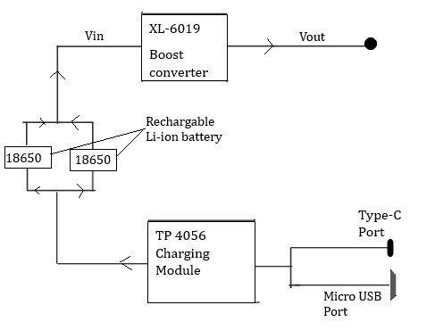
CIRCUIT DESIGN
Power Source
Battery Charging Module (TP-4056)
Type-C and Micro USB Ports
Switch
Boost Converter (XL6019)
The power supply circuit provides a robust and flexible power source for the gas detection project.
It ensures continuous and stable power to the Arduino Uno and gas sensors.

Slide 24
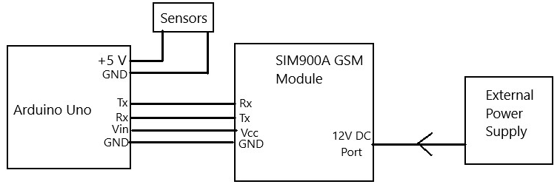
Circuit Connection
Arduino Uno Connections
Gas Sensors (MQ-135 and MQ-7) Connections
AGS02A (TVOC Sensor) Connection
DHT11 Temperature and Humidity Sensor
XL6019 Boost Converter and Switch
TP-4056 Charging Module
SIM900A GSM Module

Slide 25
PROGRAMMING
The Arduino IDE (Integrated Development Environment)
Code Editor
Library Manager
Serial Monitor
Board Manager
Sketch Upload
Examples and Tutorials

Slide 26
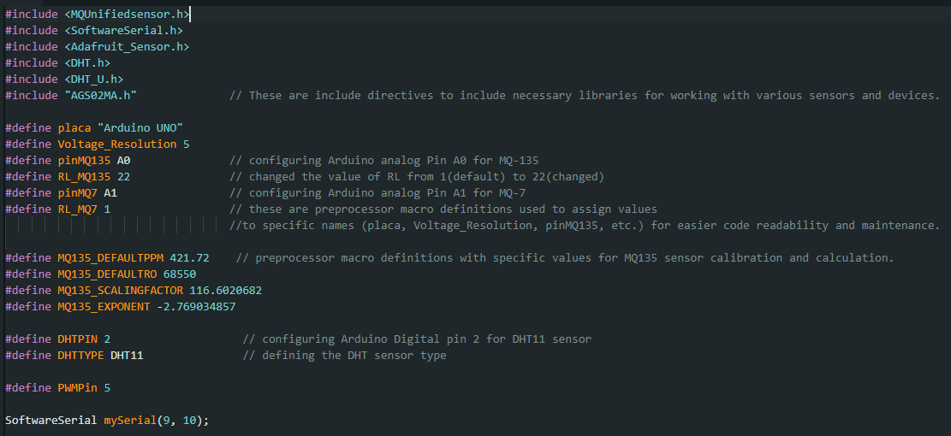
CODE

Slide 27
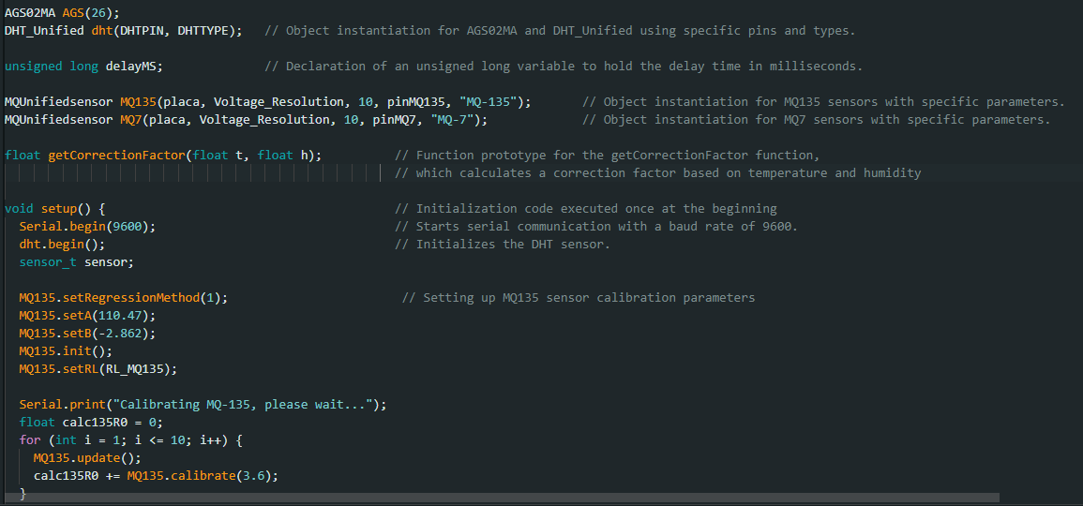

Slide 28
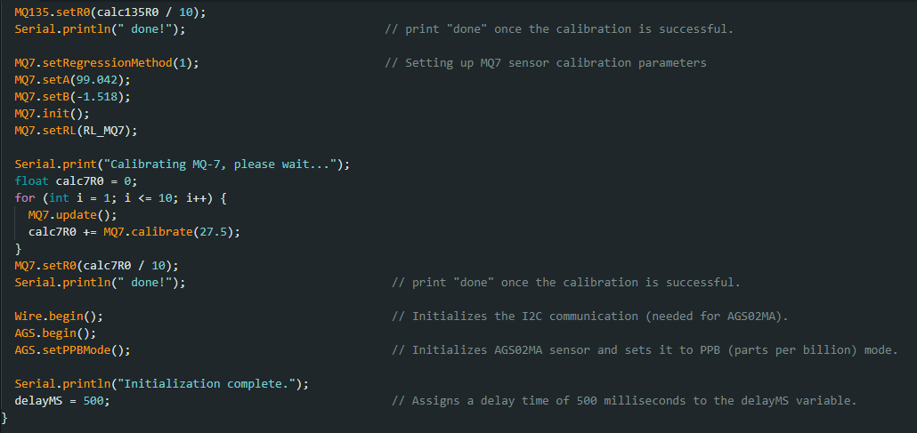

Slide 29
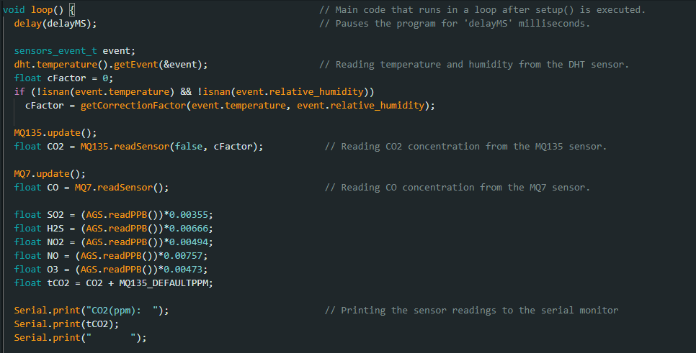

Slide 30


Slide 31


Slide 32
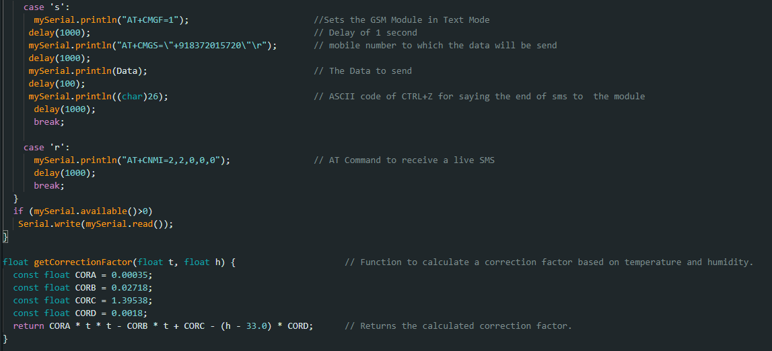

Slide 33
Execution of the Program
Library Inclusion
Macro Definitions
Global Variable Declarations
Setup Function
Calibration of Sensors
Sensor Readings in Loop
Data Sending via GSM Module
Data Receiving via GSM Module

Slide 34
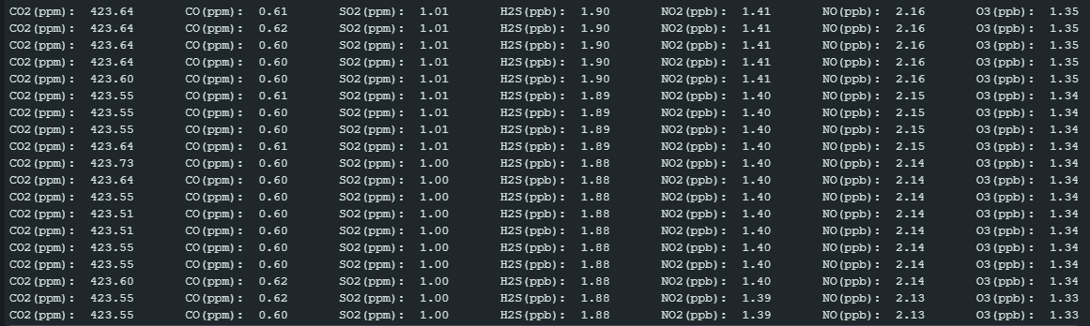
RESULTS AND OUTPUTS Output without DHT Reading

Slide 35
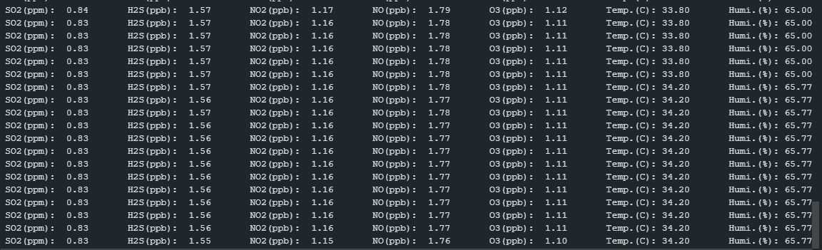
Output with DHT Reading

Slide 36
CONCLUSION
By harnessing the power of IoT technology, we aimed to create an efficient and reliable device capable of detecting and measuring multiple hazardous gases in the environment.
The core of the system, the Arduino Uno microcontroller, acted as the central hub, interfacing with the sensors and the SIM900A GSM Module for real-time data transmission.
By monitoring these gases, we contribute to safeguarding biodiversity and promoting a sustainable environment.
In conclusion, our gas monitoring IoT project marks a substantial advancement in addressing air pollution concerns.

Slide 37
FUTURE ENHANCEMENTS
These enhancements are aimed at making the system more versatile, user-friendly, and efficient in tackling environmental challenges. Some potential future improvements include:
Advanced Sensor Integration
Wireless Connectivity
Cloud-Based Data Storage
Data Visualization
Power Optimization
Real-Time Alerts

Slide 38
BENEFITS
The gas monitoring IoT device developed using Arduino Uno and various sensors offers numerous benefits that contribute to addressing air pollution and promoting a healthier and sustainable environment for Butterflies. Some of the key advantages of this device are:
Environmental Protection
Public Health Safety
Pollution Monitoring
Data-Driven Decision Making
Cost-Effective Solution
Scalability and Versatility
User-Friendly Interface

Slide 39
REFERENCES
Internet of Things (IoT): Principles, Paradigms and Applications of IoT by Dr Kamlesh Lakhwani
Arduino for Beginners by makerspaces
Programming with Arduino by Hans-Petter Halvorsen
SIM900A Details
Arduino Code Optimization from ChatGPT
GitHub repository for the Calibration of AGS02MA

Slide 40
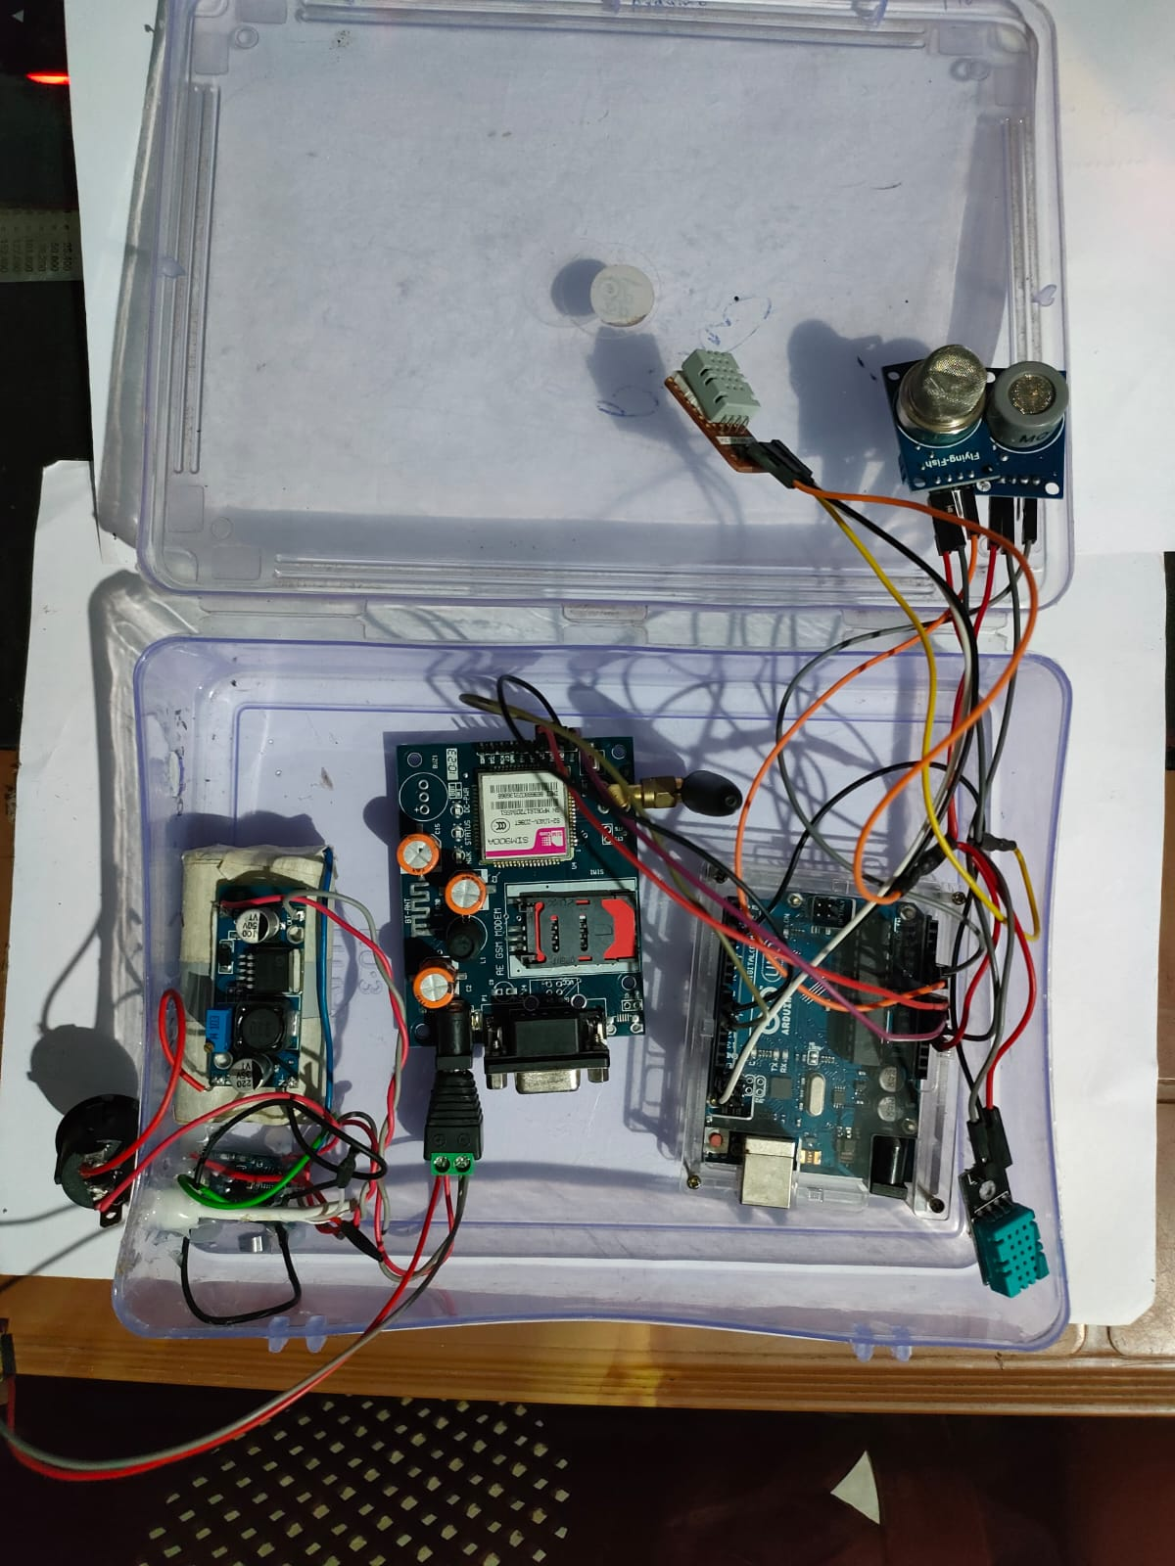
System Connection

Slide 41

Thank You

